Slide 1
中国诗词
CHINESE POEMS
BY: JILLIAN KAROLSKI
中文3/4

Slide 2
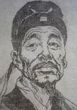
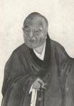
作者 (zuo zhe)- AUTHORS
罗隐 Lao yin
唐代诗人。生于公元八百和三十三
Táng dài shīrén. Shēng yú gong yuán bā bǎi hé sān shí sān
在七十七 岁去世
Zài qī shí qī suì qùshì
Tang Dynasty poet. Born in AD 833. Died at the age of 77.
骆宾王 Luo bin Wang
初唐诗人
Chū táng shī rén
意气风发，尊重神
Yì qì fēng fā, zūn zhòng shén
Early Tang dynasty poet. high-spirited, respect for the gods

Slide 3
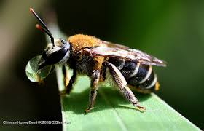
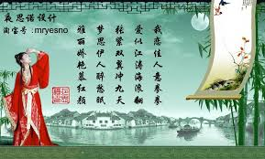
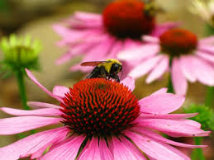
蜂(feng) – Bee
作者(zou zhe-author) - 罗隐 Luo Yin
原文 (yuan wen- original)
不论平地与山尖，无限风光尽被占.
采得百花成蜜后，为谁辛苦为谁甜
Bù lùn píng dì yǔ shān jiān, wú xiàn fēng guāng jǐn bèi zhàn
Cǎi dé bǎihuā chéng mì hòu, wèi shuí xīnkǔ wèi shuí tián
Translation: Regardless of the plains and hilltops, unlimited scenery to make the occupied.
Picked flowers into honey, for whom for whom hard sweet.

Slide 4
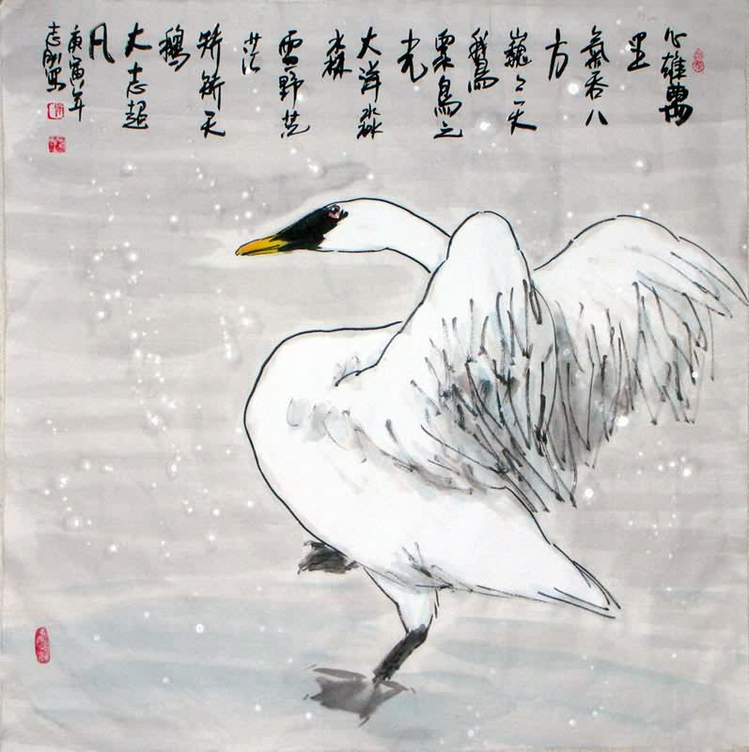
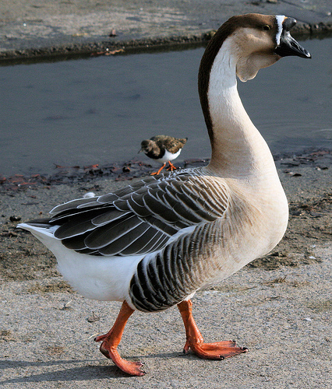
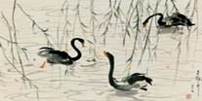
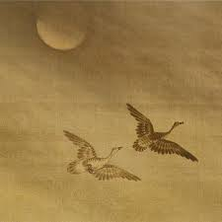
咏鹅(yong e) – Goose
作者(zuo zhe): 骆宾王 (luo bin wang)
原文 (yuan wen- original)
鹅鹅，曲项向天歌。白毛浮绿水，红掌拨清波.
É é, qū xiàng xiàng tiān gē. Bái máo fú lǜ shuǐ, hóng zhǎng bō qīng bō.
Translation: Goose goose, crooked to Tiange. White hair floating green water, Anthurium dial Shiba.

Slide 5
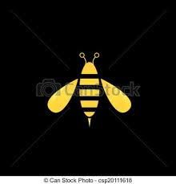
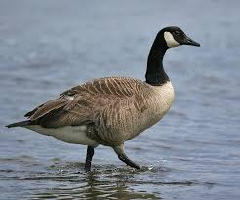
Comparison of the two poems
Different 不同
Similar 同
They are both animals.
Both authors were from the Tang Dynasty.
The poems were both talking about the animals in their habitat.
Both animals are performing a task
The goose is swimming
The bee pollenating and making honey
The poems were written by different authors.
The poems are different lengths.
The animals are in different scenery.
The goose is in the green water.
The bees are in the plains, pollenating on the flowers.

Slide 6
REFLECTION
How do you feel about these poems?
When I read these poems, I felt happy because the poems had a bigger story than what it was saying. The goose and the bees are just small pieces of nature.

