Slide 1
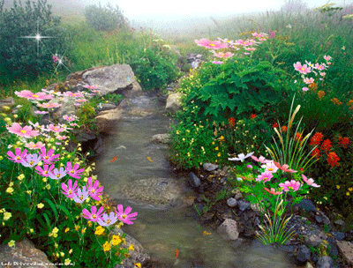
Chinese Poems 中文诗词 zhōng wén shī cí
By: Jessica Pike
白巧涓
中文 5/6

Slide 2
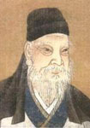
春晓 Chun Xiao - Spring Dawn 孟浩然 Meng Hao ran
孟浩然 是 《田园诗人》(tian yuan shi ren )。 A pastoral poet.
生于 唐代 Tang dai (Tang Dynasty) B.C.689-740。
Author information click here
春眠不觉晓，处处闻啼鸟。
Chun mian bu jue xiao, chu chu wen ti diao.
夜来风雨声，花落知多少。
Ye lai feng yu sheng, hua la zhi duo shao.
Poem translation – click here

Slide 3
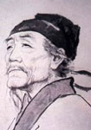
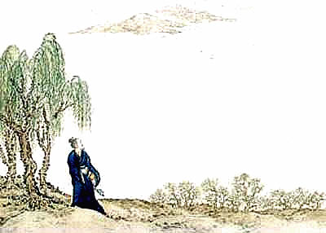
春望Chun Wang – Spring View 杜甫 Du Fu
国破山河在，城春草木深。
Guo po shan he zai, chengchun cao mu shen.
感时花溅泪，恨别鸟惊心。
Gan shi hua jian lei, hen biediao jing xin.
烽火连三月，家书抵万金。
Feng huo lian san yue, jia shu di mo jin.
白头搔更短，浑欲不胜簪。
Bai tou sao geng duan, hun yu bu sheng zan.
杜甫 是 《现实主义诗人》(xiàn shí zhǔ yì shi ren )。
A realistic poet.
杜甫 is often described as a 《诗圣》((shī shèng) poet-historian
生于 唐代 Tang dai (Tang Dynasty) B.C.712-770。
Author :du fu introduction click here
Poem translation click here

Slide 4
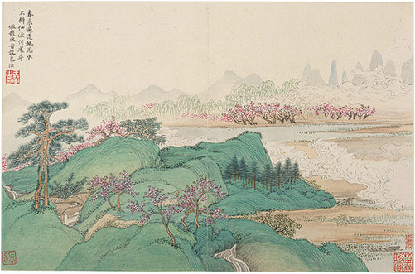
Compare the two poems: 比较 bǐ jiào
Similarities 同
These poems are both related to spring time.
The authors are both from the Tang Dynasty . Mr. Meng is 13 yrs older than Mr. Du.
The poems both talk about how the flowers and trees look and birds. Both use a lot of nature objects.
Difference 不同
These poems have different authors
春晓 is talking about the wind and rain blowing the flowers away
春望 is talking about the end of the war and the homesickness

Slide 5
My reflection: 感想
How do you feel about the poem? I feel that these poems both resemble a new beginning.
Why you feel that way? I feel this way because the poems both talk about how the atmosphere around them has changed so dramatically.
Which sentence(s) move(s) you the most? 春眠不觉晓,
Any English/American literature has similar meaning? These poems can relate to American Literature because many poets write about springtime. e.g. The Prologue to The Canterbury Tales by Geoffrey Chaucer
Click here to read The Prologue to The Canterbury Tales

Slide 6
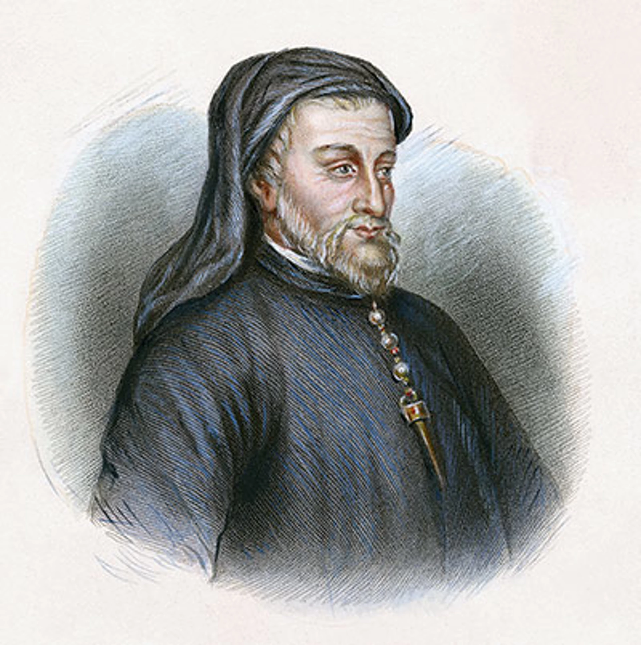
The Prologue to The Canterbury Tales Geoffrey Chaucer
“Whan that Aprille with his shoures soote / The droghte of Marche hath perced to the roote…” (When April with his sweet showers, has pierced the drought of March to the root).Chaucer’s spring, more than 600 years later, is as fresh as ever – his verses have a spring in their step. “And smale fowles maken melodye, / That slepen al the night with open ye /” (And small birds make melody, that sleep all night with open eyes). In this restless season “Than longen folk to goon on pilgrimages…” Chaucer’s words encourage us if not to pack for a pilgrimage, at least to wake up and be cheerful

Slide 7
谢谢！ 再见

