Slide 1
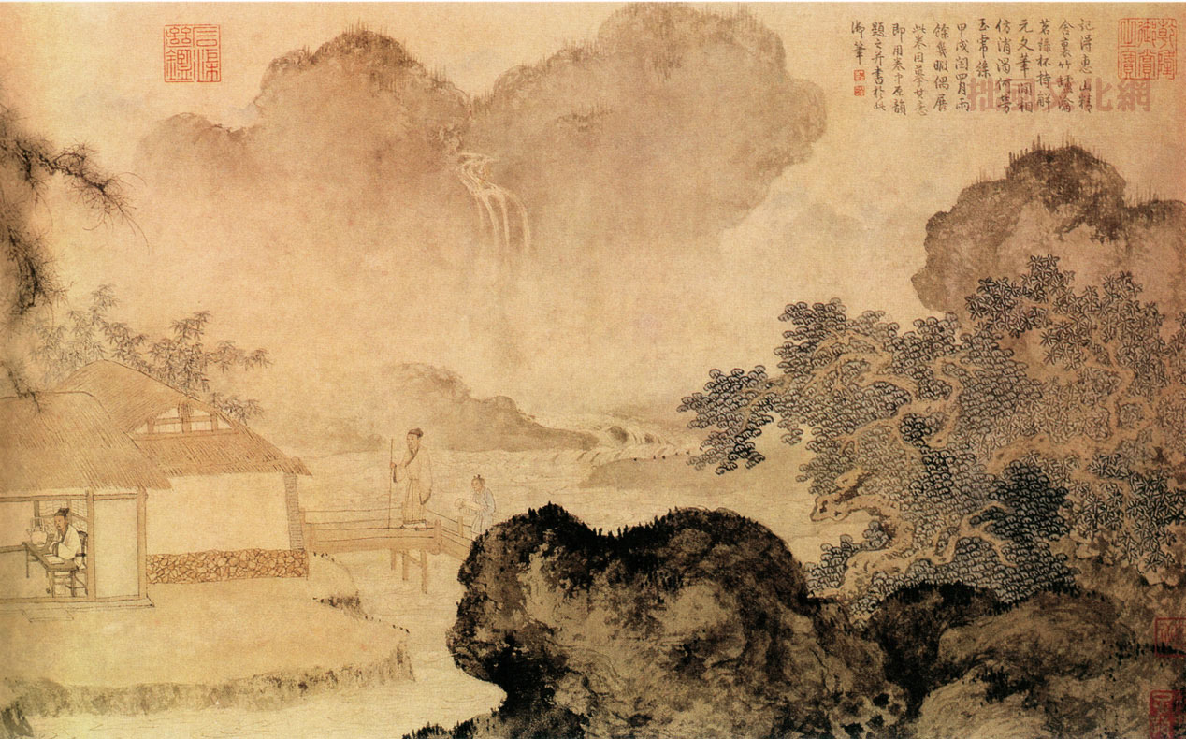
中国文学 Chinese Literature
By Daniel Fox
方大年
中文 3/4

Slide 2
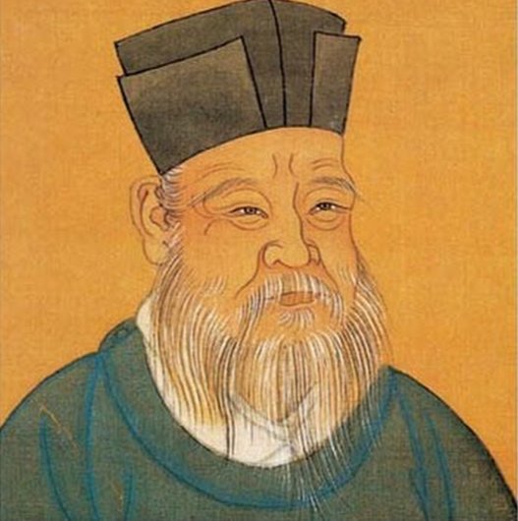
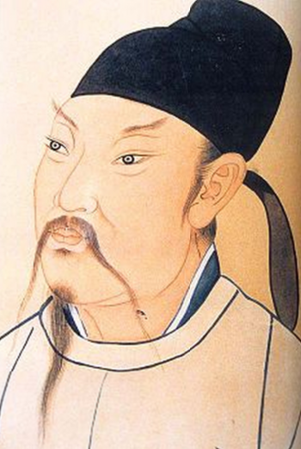
作家
邵雍（一零一一 – 一零七七年）
中文老师和诗人
发达学校理学
李白（七零一-七六二年）
唐代诗人和浪漫

Slide 3
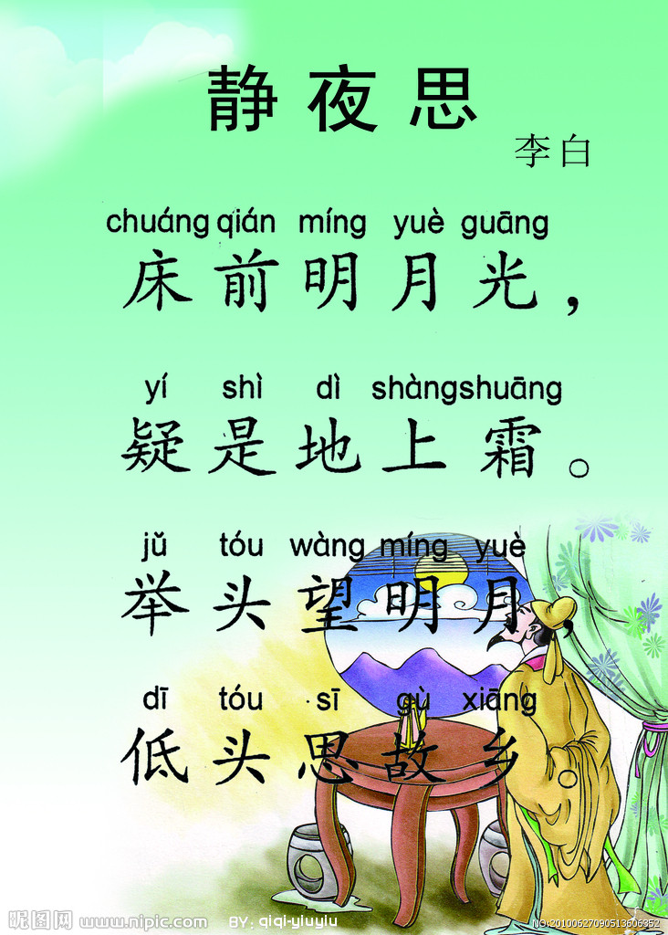
介绍
English translation click here
故事有村，家，树和花
一二三四五六七八九十
作者看明月
作者思故乡（想家）

Slide 4
jìng yè sī -静夜思-
Nostalgia By Li Bai 李白 *Before my bed, the moon is shining bright, *I think that it is frost upon the ground. *I raise my head and look at the bright moon, *I lower my head and think of home.
Yí wàng èr sān lǐ -一望二三里
A leasuire walk
By Shao Yong – 邵雍
*Once a time, we walk leisurely for two or three miles
*On the way, we see four or five villages
*Six or seven temples and
*Eight , nine or ten branches of flowers

Slide 5
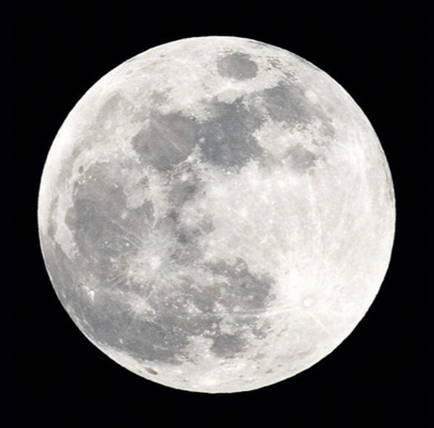
同
Both stories are poems
Both stories are in the same tone
Both authors are from China
Both authors are men
Both poems include the character seeing interesting things in nature

Slide 6
不同
Written by different authors
Authors are from different time periods
Authors used a different amount of words
One setting is outside and the other is inside

Slide 7
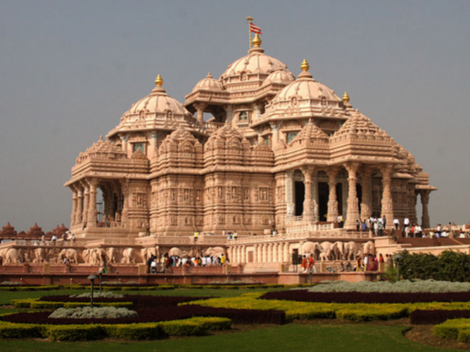
感想
I enjoyed reading both poems. They both are have an upbeat tone and inspire me to go outside. The nature theme is clear in both poems due to being a large aspect in the authors’ lives.

